Slide 1
DESCRIPTIVE STATISTICS and CONFIDENCE INTERVAL
MASTER OF PUBLIC HEALTH PROGRAM
STAT 7311 - BIOSTATISTICS
LECTURE 3
Muhammad Adil Zainal Abidin
“Statistics is the grammar of science” Karl Pearson
(1857 – 1936, influential English mathematician)

Slide 2
TOPIC LEARNING OUTCOME
Describing and analyse measures of central tendency and dispersion.
Describe concept of sampling distribution for proportion and its confidence interval
Describe concept of sampling distribution for mean and confidence interval
Interpret and reporting data summary

Slide 3
Descriptive statistics
Numerical summaries of data sets
Exploratory data analysis (EDA) to generate hypothesis
In any study , before we answer our research questions, we explore the characteristics of the variables (e.g the age, gender, ethnicity).
Use descriptive statistics
Categorical data
Continuous data

Slide 4

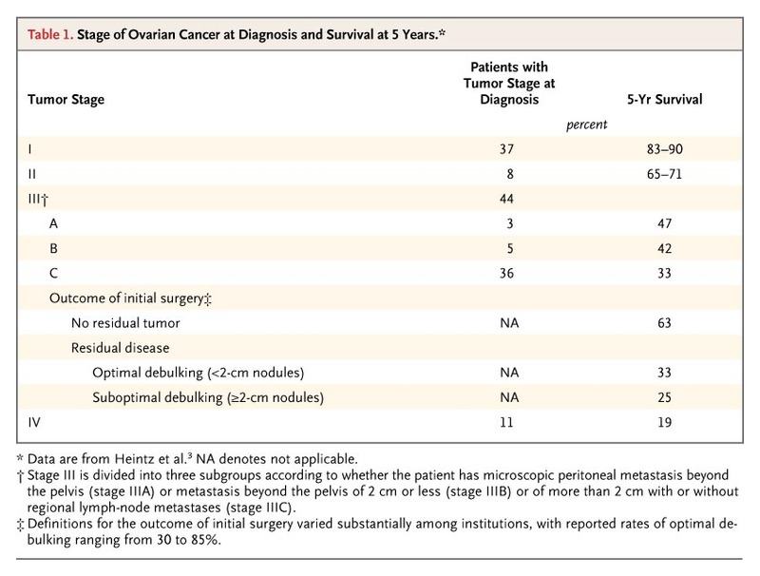
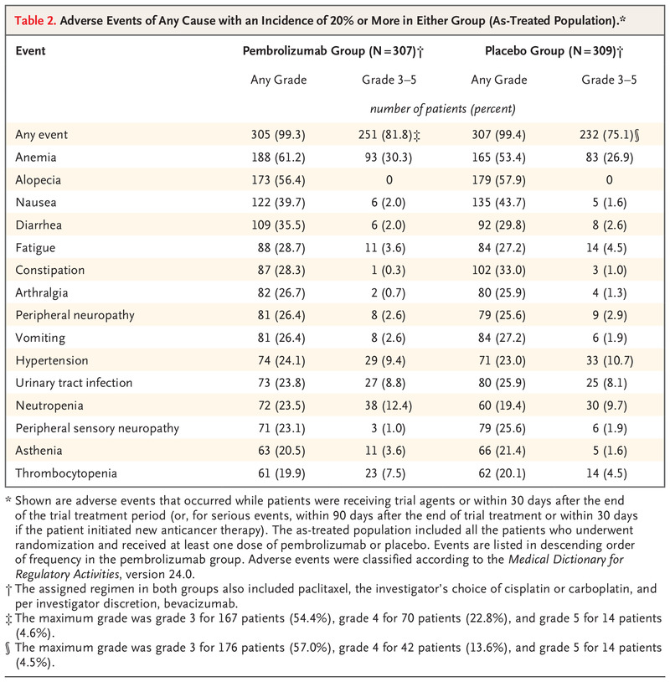
Descriptive statistics
Categorical data
Frequencies
Percentages
Fractions and/or relative frequencies
Cross tabulations
Continuous data
Measure of central tendency
Mean, median, mode
Arithmetic mean, geometric mean
Measure of dispersion
Standard deviations, variance, interquartile range, min, max

Slide 5
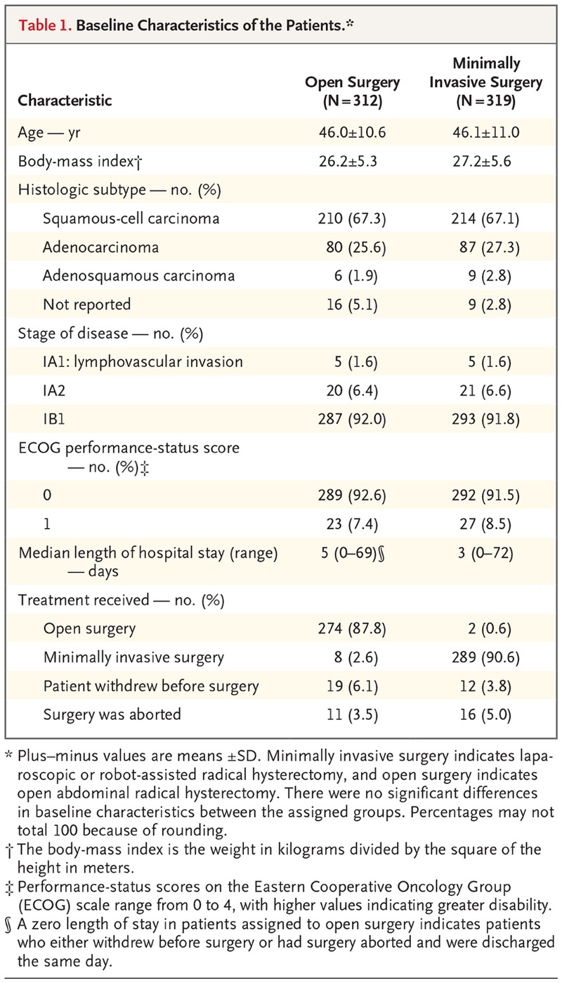
Descriptive statistics
Categorical data
Frequencies
Percentages
Fractions and/or relative frequencies
Cross tabulations
Continuous data
Measure of central tendency
Mean, median, mode
Arithmetic mean, geometric mean
Measure of dispersion
Standard deviations, variance, interquartile range, min, max

Slide 6
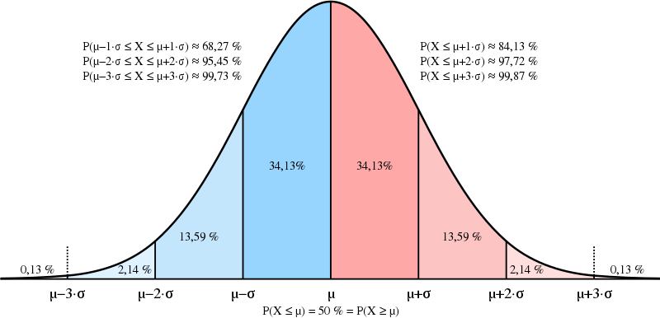
PRINCIPLE OF STATISTICS
Sampling technique to represent population
Random sampling
Sample size
Distribution of data
Normal distribution
Central limit theorem
Other distribution
Assumption for most statistical inference
Assumption for many statistical test
It is a capital mistake to theorize before one has data. Sir Arthur Ignatius Conan Doyle
(1859 – 1930, Scottish physician and writer, most noted for his stories about Sherlock Holmes)
Notes:
Statistics is the science of data – describe, presenting, analyse , testing your hypothesis
Not only analyse the data, but the science of collecting, cleaning, curating
So we can’t runaway from the methodology part, sampling, sample size

Slide 7
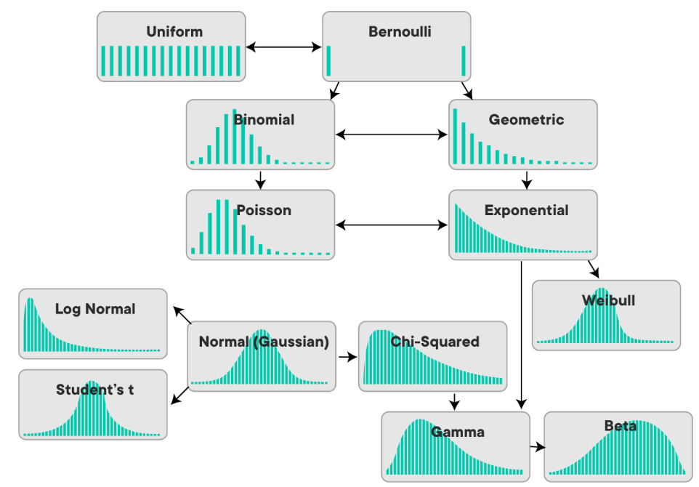
Distribution of data
Applicable to numerical value
Discrete or Continuous data
Discrete ~ binomial, Poisson, Negative binomial, Multinomial etc
Continuous ~ Normal, t, F, Chi square

Slide 8
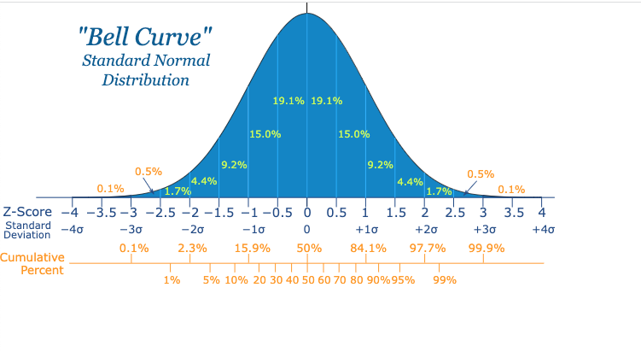
Normal distribution or Gaussian distribution
Most natural phenomena observe this normal distribution
Characteristics of normal distribution
It is “Bell-Shaped” and has a single peak at the center of the distribution
The arithmetic Mean, Median and Mode are equal.
The total area under the curve is 1.00
Half the area under the normal curve is to the right of this centre point and the other half to the left of it
It is Symmetrical about the mean
It is Asymptotic: The curve gets closer and closer to the X – axis but never actually touches it.
To put it another way, the tails of the curve extend indefinitely in both directions.
The location of a normal distribution is determined by the Mean, µ
The Dispersion or spread of the distribution is determined by the Standard Deviation, σ.
Notes:
Distribution of data is very important, as the properties of the distribution

Slide 9
MEASURES OF CENTRAL TENDENCY

Slide 10
MEASURES OF CENTRAL TENDENCY
When we examine a set of quantitative data, we usually use numerical measures to describe important features of the data. Usually we are interested in statistics (such as the mean) from our sample only to the extent to which they can infer information about the population.
The measure of central tendency or measure of central location is a measure indicating the center of a set of data which is arranged in increasing or decreasing order of magnitude.
The confidence intervals for the mean give us a range of values around the mean where we expect the "true" (population) mean is located (with a given level of certainty).

Slide 11
MEASURES OF CENTRAL TENDENCY
The most commonly used measure of central tendency are : Mean, Median, Mode
The most familiar measure of central tendency is the mean. The mean is the descriptive measure most people have in mind when they speak of the ‘average’.
The mean is a particularly informative measure of the "central tendency" of the variable if it is reported along with its confidence intervals.
Self study : arithmetic mean and geometric mean

Slide 12
PROPERTIES OF MEAN
Uniqueness : For a given set of data there is only one and one arithmetic mean.
It is simple to calculate and easy to understand
Since each value enters into the computation of the mean, it is affected by each value. Extreme values therefore , have influence on the mean and in some cases may distort it that it becomes undesirable to be used as a measure of Central tendency.
Mean should NOT BE USED when extreme values are found in a set of data

Slide 13
PROPERTIES OF MEAN
Note that the width of the confidence interval depends on the sample size and on the variation of data values.
The larger the sample size, the more reliable its mean. The larger the variation, the less reliable the mean .
The calculation of confidence intervals is based on the assumption that the variable is normally distributed in the population.
The estimate may not be valid if this assumption is not met, unless the sample size is large, say n=100 or more.

Slide 14
MEDIAN
The median is the value of the variable or score found at the exact middle of the set of values arranged in an ordered array.
The median is the middle observation in a set of data when the data has been arranged in order from the lowest to the highest value. It divides the array of data into 2 halves.
The value is also the 50th percentile observation as 50% of the observations lie below it.
Importance of the median
The median is not affected by extreme of values.
As such is a better measurement of central tendency of a set of data where there are extreme of values present.

Slide 15
MEDIAN
If there are odd number of observations, the median will be the middle value when all the values has been arranged in order from the lowest to the highest value.
If there are even number of observations, the median is the mean of the two middle values in the set of data.
Examples:
The median for 2, 4, 7, 12, 23 = 7
The median for 3,7,8,29 = 1⁄2 (7+8)

Slide 16
MEDIAN OF GROUPED DATA
Median = lm + Wm ( n / 2 - Cf ) / Fm
Where :
lm = true lower limit or class boundary of the median class
Wm= width of the median class
n = total number of observations
Cf = cumulative frequency of the class before the median class
fm = frequency of the median class

Slide 17
MEDIAN OF GROUPED DATA
Steps for computing the median of grouped data
1. Construct the cumulative frequency column
2. Identify the median class ie. The first class whose cumulative
frequency is > n / 2
3. Determine the true lower limit (lm) or the class boundary, the
width (Wm) and the frequency (fm) of the median class
4. Substitute the value in ( c ) in the equation.

Slide 18
MODE
• The most frequently occurring observed value in a set of data is called the mode.
• The mode is of some interest but seldom is of any statistical value.
• If there are several numbers that share the same number of occurrence, each of them is the mode.
• Example : the mode for the set of data :
25, 7, 12, 6, 13, 25, 13,3,9,16
Mode = 13 & 25 (bimodal)

Slide 19
EXTREME VALUES AND OUTLIERS
For statistics, an extreme value (outlier) can be identified using the interquartile range (IQR) and a formula like
Q1 - ( 1.5 x IQR) or Q3 + (1.5 X IQR)
SPSS - Mild outliers 1.5, Extreme 3.0
Common methods to identify outliers include z-scores, box plots,
And tests like Grubbs' test (Rstudio, assume data normal)
Rosner's test (Rstudio assume data normal)
Dixon's test (Rstudio for small sample)

Slide 20
MEASURES OF DISPERSION

Slide 21
MEASURES OF DISPERSION
Is an average by itself not adequate for describing a set of variables or their distribution?
NO, an average by itself is not adequate for describing a set of variables or their distribution because it only gives information as to the tendency of the values to clump together.
IT DOES NOT measure the spread or degree of variability present. As such we need another group of parameters , measures of dispersion

Slide 22
MEASURES OF DISPERSION
A measure of dispersion conveys information regarding the amount of variability present in the set of data.
If all the values are the same, there is no dispersion, if they are not he same , dispersion is sure to be present.
The amount of dispersion may be small if the values are close to each other.

Slide 23
MEASURES OF DISPERSION
MINIMUM MAXIMUM
RANGE
VARIANCE
STANDARD DEVIATION
COEFFICIENT OF VARIANCE

Slide 24
RANGE
• Range is the difference between the highest and the lowest value in a set of data.
Range = highest value - lowest value
R = x L – x S where R = range
x L = largest value
x S = smallest value
Example : the range for :
21, 50, 98, 11, 50 = 98 - 11 = 87

Slide 25
VARIANCE
Indicates how closely each individual values are scattered around the mean.
• The variance is computed by subtracting the meN from each of the values, square the resulting difference and than add up the the squared differences. This sum of the squared deviations of the values is divided by (the sample size minus 1).
Variance is the average squared deviation from the mean.
S²= ∑(x_{i} – x )² / (n – 1)

Slide 26
VARIANCE
The variance is a more accurate measure of dispersion because even a single outlier value (extremely large or small) in the data set can greatly exaggerate the range. In short, the variance shows the relationship that the values in the data set have to the mean of the sample.
The greater the homogeneity (similarity) of the values in the data set, the smaller the variance value. The variance may vary from 0 to infinity and it is measured in squared units.
The variance represents squared units and therefore is not an appropriate measure of dispersion when we wish to express this concept in terms of the original units.

Slide 27
STANDARD DEVIATION
Is the positive square root of the variance
It reflects the dispersion of scores so that the variability of different distributions may be compared in terms of standard deviation.
It reflects the average of the spread of the observations about the mean
The greater the dispersion, the larger will be the standard deviation
It is usually used in Quantitative data

Slide 28
STANDARD DEVIATION
Indicates how closely individual values are scattered around the mean
It permits the precise interpretation of scores within a distribution
If the distribution is symmetrical and uni-modal, an approximate % or proportion of items can be established
68% of the cases will fall within one SD of the mean
95% within 2SD of the mean
99.7% within 3SD of the mean

Slide 29
COEFFICIENT OF VARIANCE
The Variation of the same character in two or more different series has to be compared quite often.
We may be interested to know whether the weight varies more in the spleen or in heart or the liver ?
Does growth vary more in males or females?
Does the pulse varies more in the youth or adults?
We could use the coefficient of variation to answer some of these questions

Slide 30
COEFFICIENT OF VARIANCE
The Coefficient of Variation (CV)is the measure of relative variation expressed as a percentage.
• It expresses the standard deviation as a percent of the mean.
• It compares the variability irrespective of the units of measurements used in two or more distributions such as heights in one and inches in the other or pulse rate in beats and blood pressure in mm of Hg.
• CV = standard deviation X 100 / mean

Slide 31
It can be used to compare the variability of two or more variables measured on different scales.
• Eg. We could CV to compare the variability in weights of one sample of subjects whose weights are expressed in pounds with the variability in weights of another sample of subject whose weights are expressed in kilograms.

Slide 32
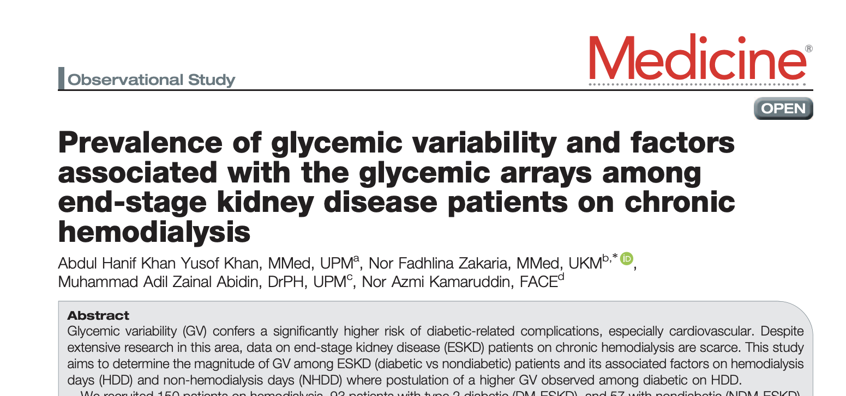
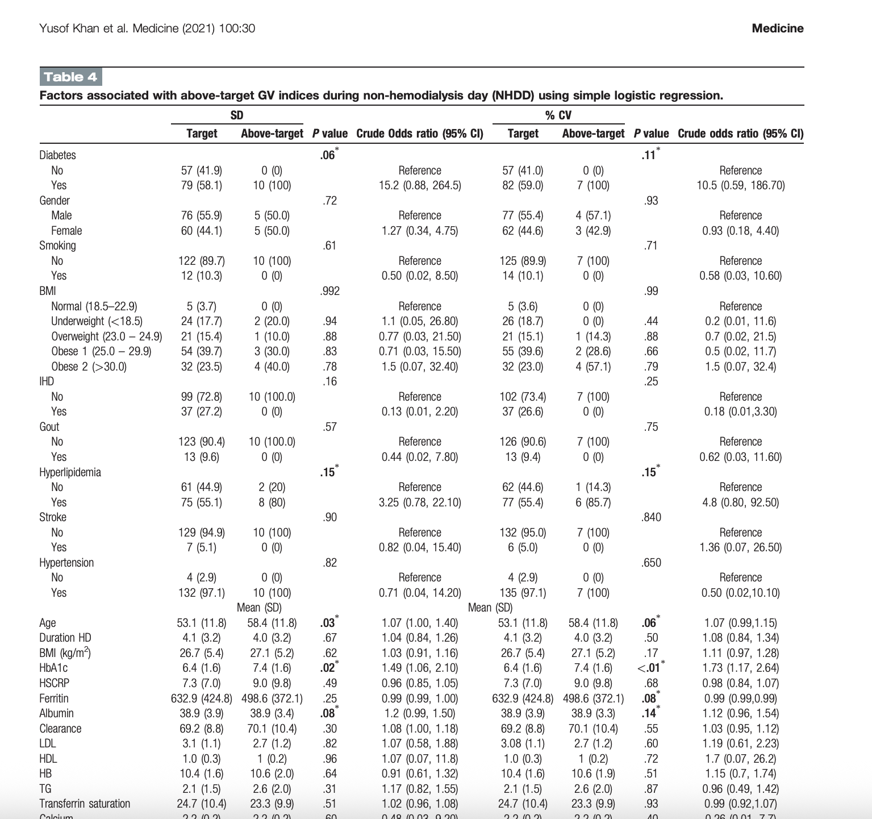
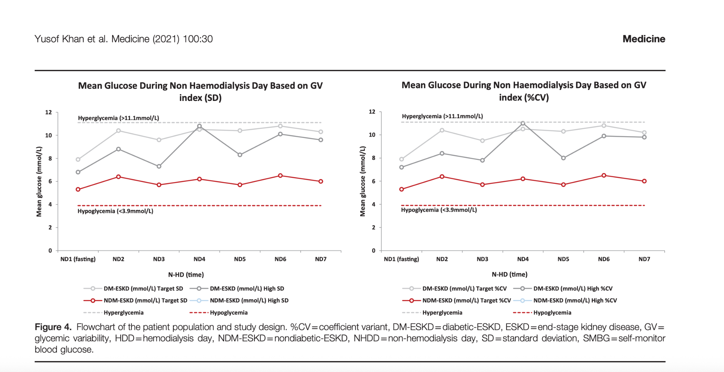
Khan, A. H. K. Y., Zakaria, N. F., Zainal Abidin, M. A.., & Kamaruddin, N. A. (2020). Prevalence Of Glycaemic Variability (GV) And Factors Associated With The Glycaemic Arrays Among End-Stage Kidney Disease (ESKD) Patients On Chronic Haemodialysis.
https://journals.lww.com/md-journal/fulltext/2021/07300/prevalence_of_glycemic_variability_and_factors.30.aspx

Slide 33
INTERQUARTILE RANGE
In descriptive statistic, the interquartile range (IQR), also called the midspread, middle fifty and middle of the #s, is a measure of statistical dispersion, being equal to the difference between the third and first quartiles.
Unlike the (total) range, the interquartile range is a robust statistic, having a breakdown point of 25%, and is thus often preferred to the total range.
The IQR is used to build box plots, simple graphical representations of a probability distribution.

Slide 34
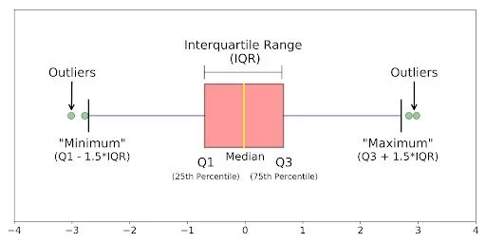
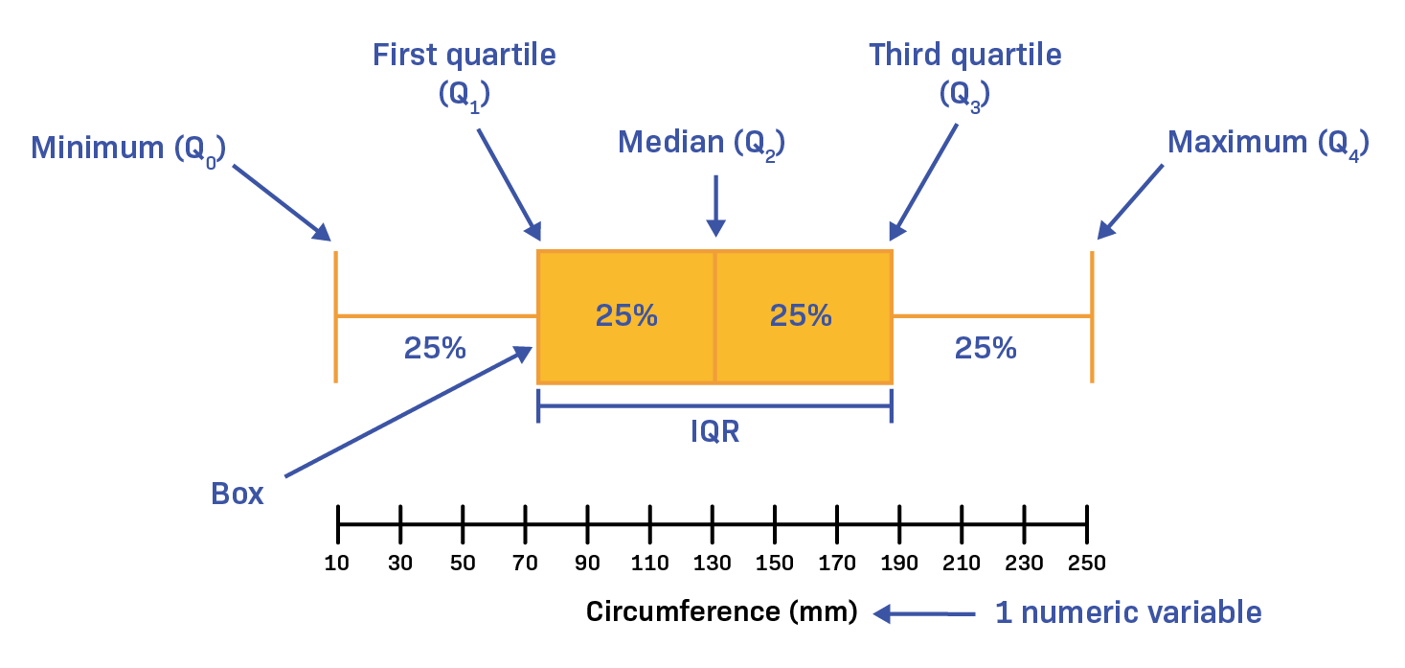

Slide 35
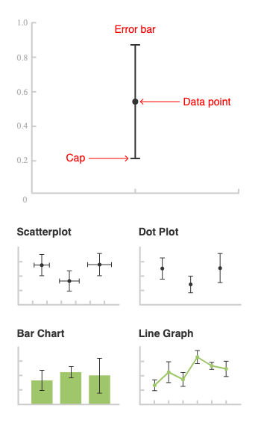
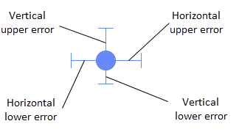

Slide 36
ALWAYS PRESENT ESTIMATE WITH ITS VARIABILITY
ESTIMATES AND ITS CONFIDENCE INTERVAL

Slide 37
SAMPLING VARIABILITY FOR PROPORTIONS

Slide 38
SAMPLING VARIABILITY FOR PROPORTIONS
Binary Variables
Variables with two categories (binary)
survival up to one year after a heart attack: alive / dead
Infection status: infected / not infected
cigarette smoking habit: smoker / non-smoker
Proportion (or x 100 gives %)
proportion dead
proportion infected
proportion who smoke

Slide 39
Sampling Distribution of a Proportion
Example
• Given
– A survey of 335 men from a general practice in a town.
– 127 men (proportion = 0.379 or 37.9%) said they were current smokers
• Required
– Express the statistical uncertainty in this proportion

Slide 40
Sampling Distribution of a Proportion Theory (1)
• Suppose we repeatedly took a new sample of 335 men from this general practice calculated for each new sample the proportion of men who are current smokers (p)
• Constructed a histogram of the values of the proportions (p)

Slide 41
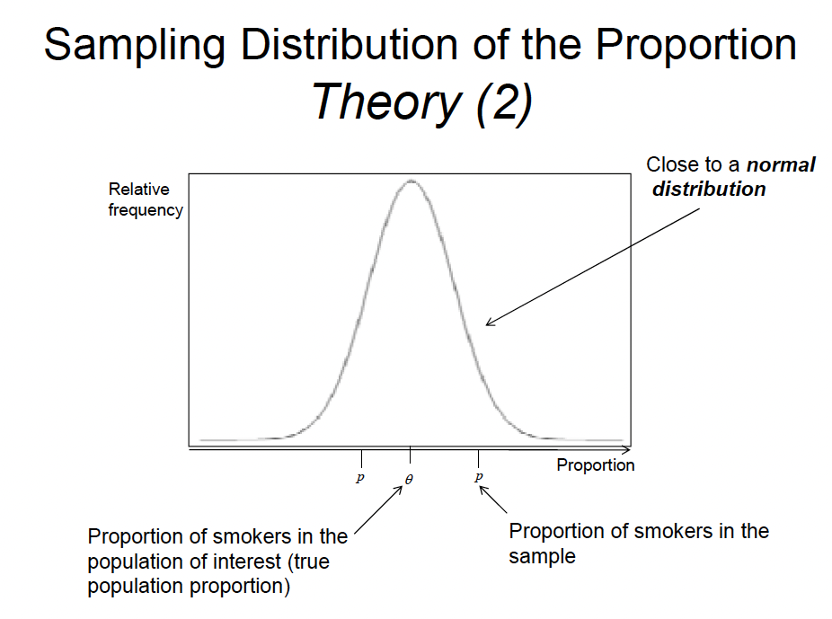

Slide 42
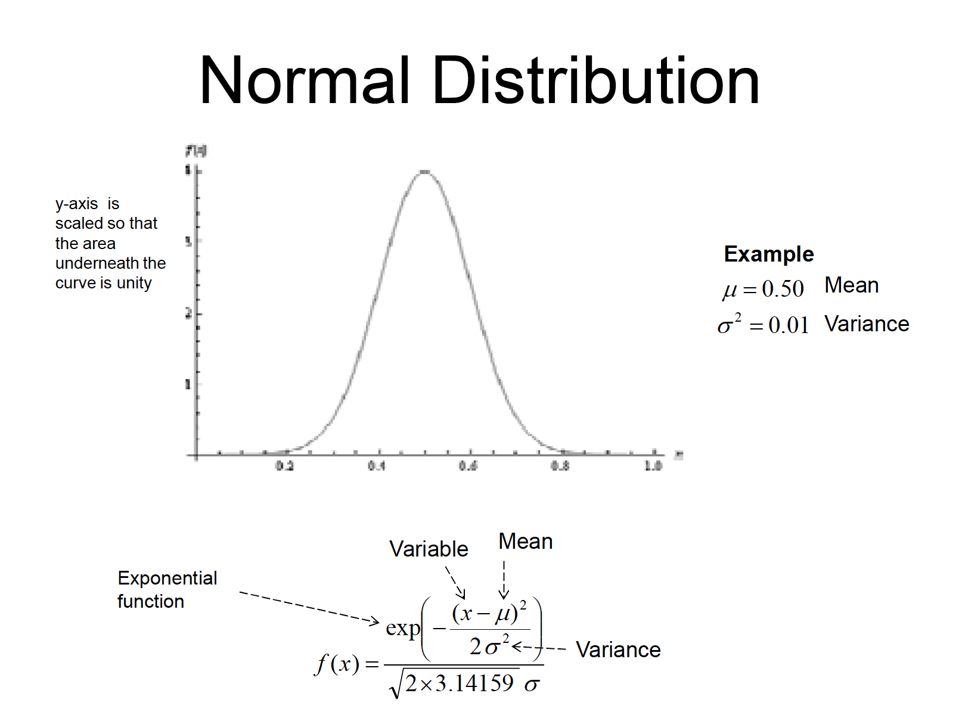

Slide 43
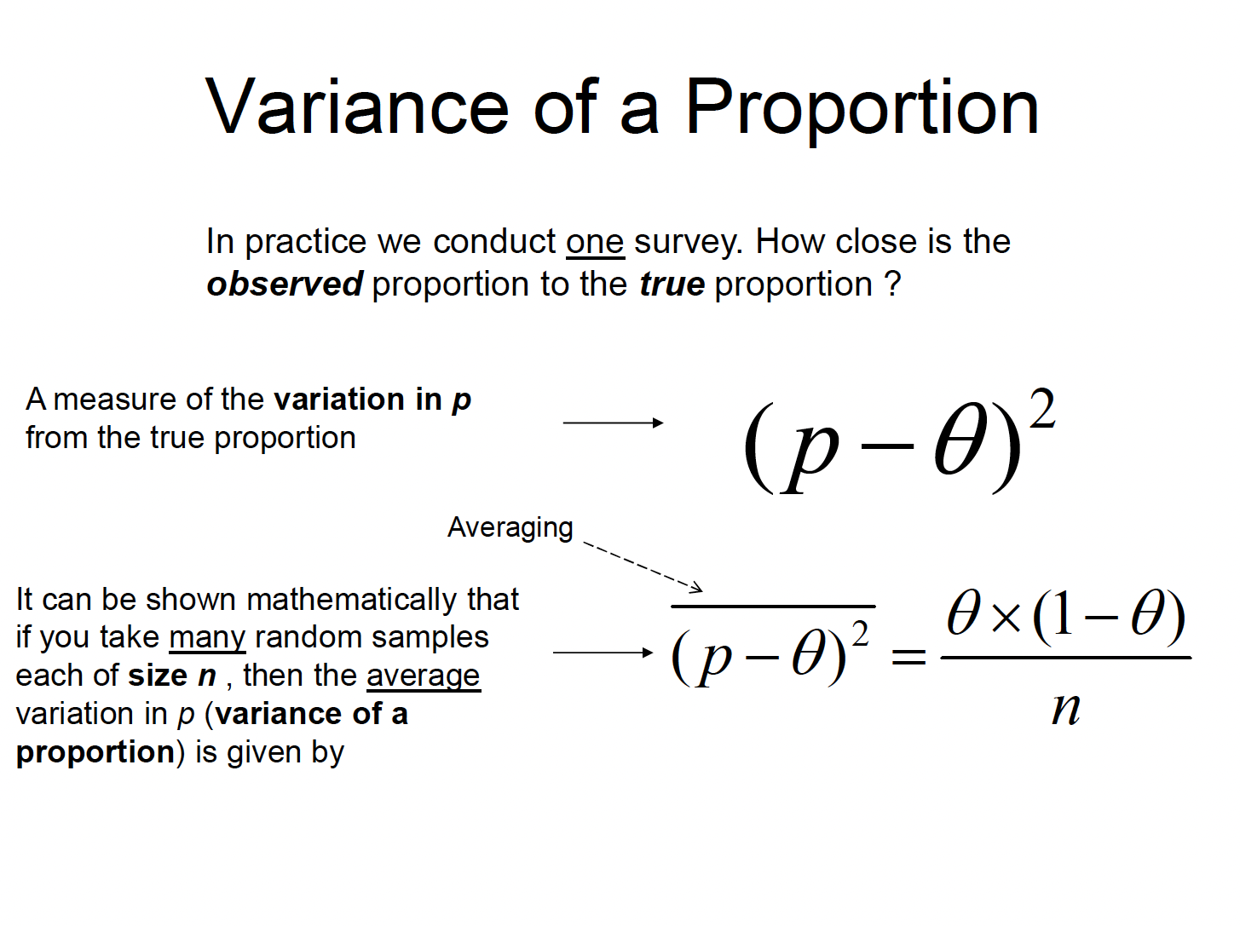

Slide 44
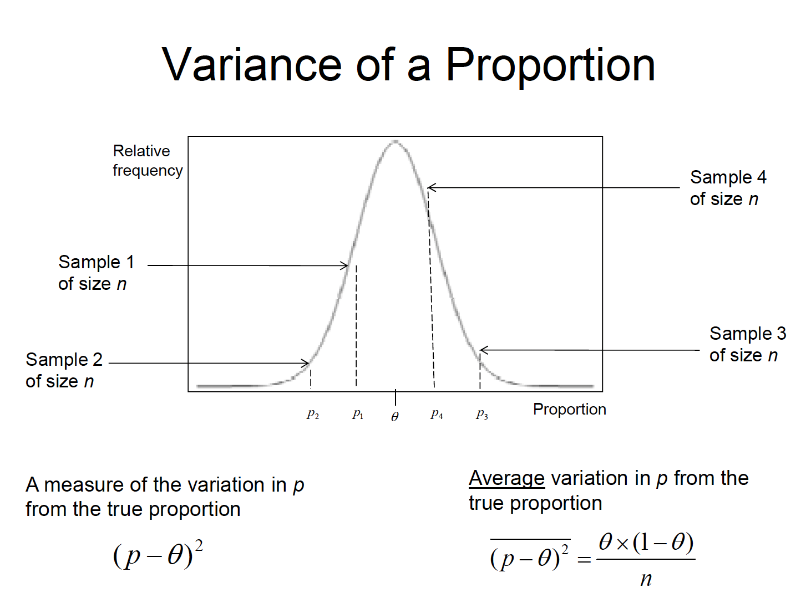

Slide 45
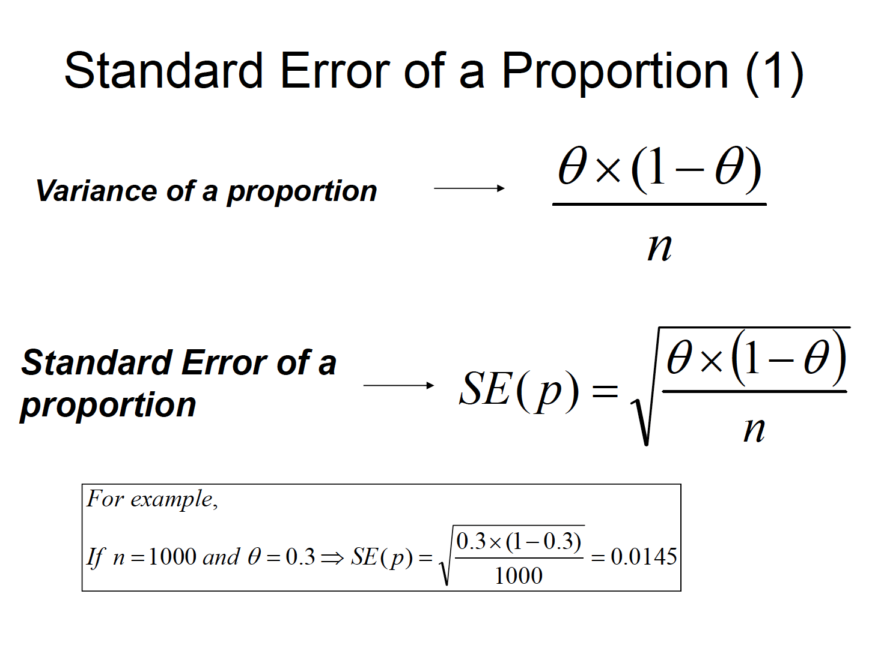

Slide 46
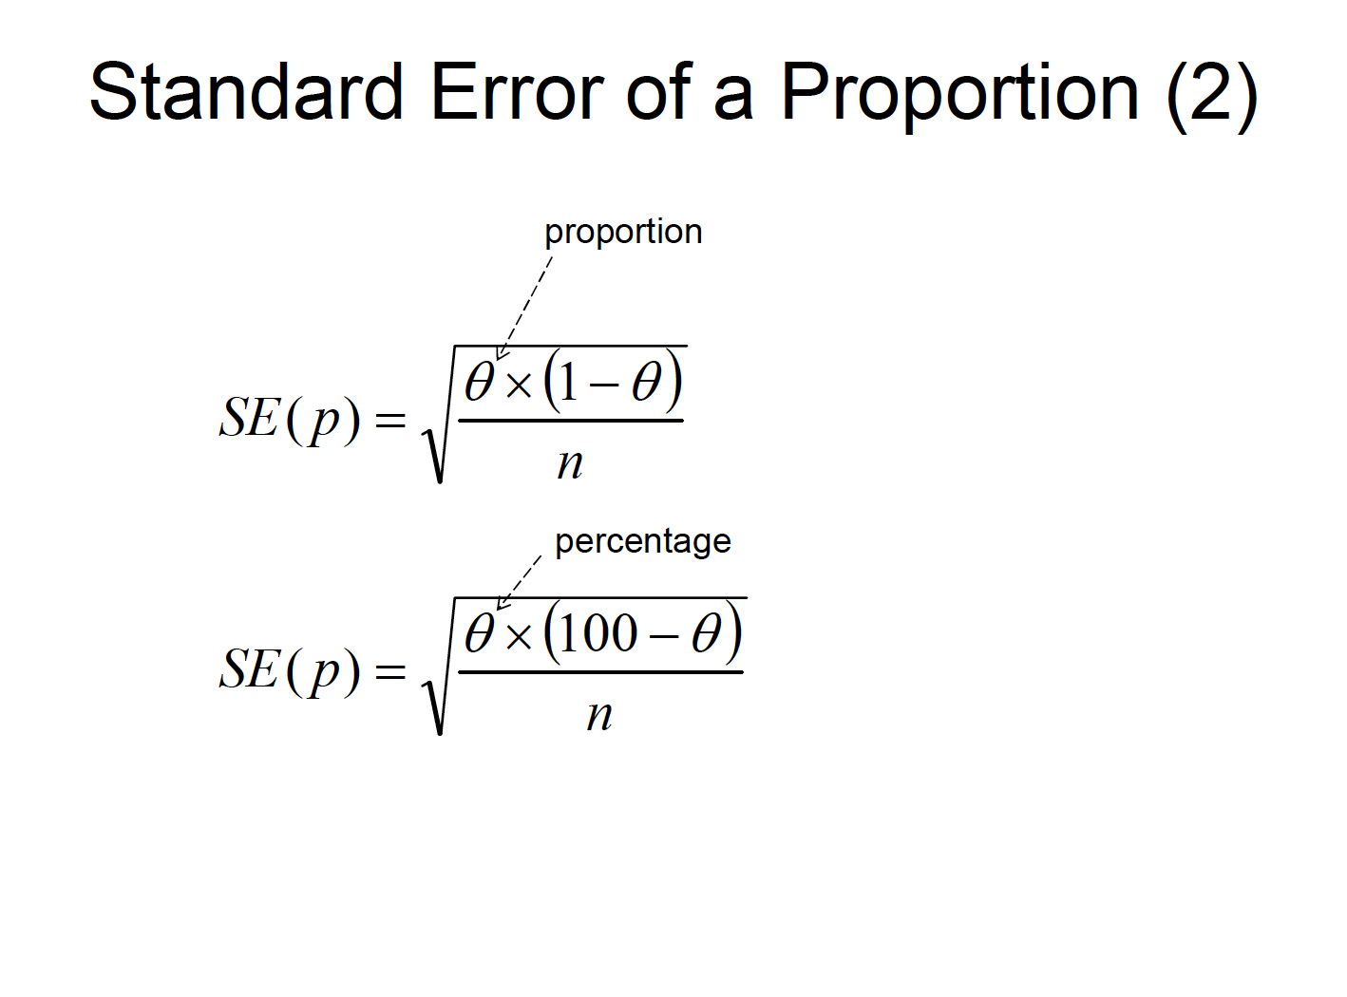

Slide 47
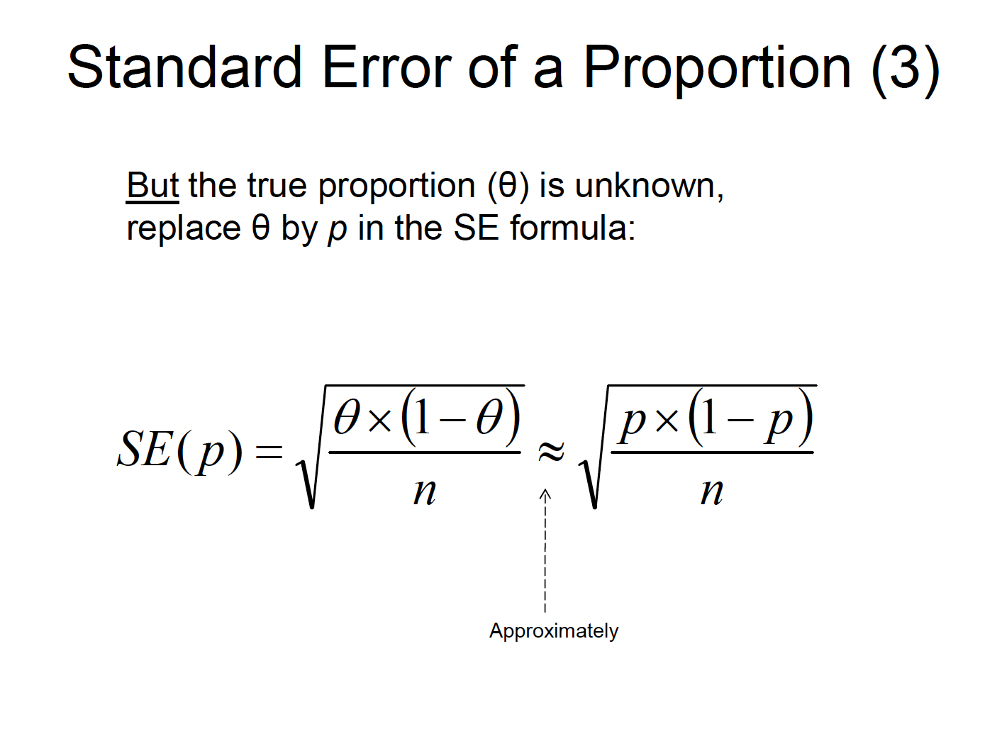

Slide 48
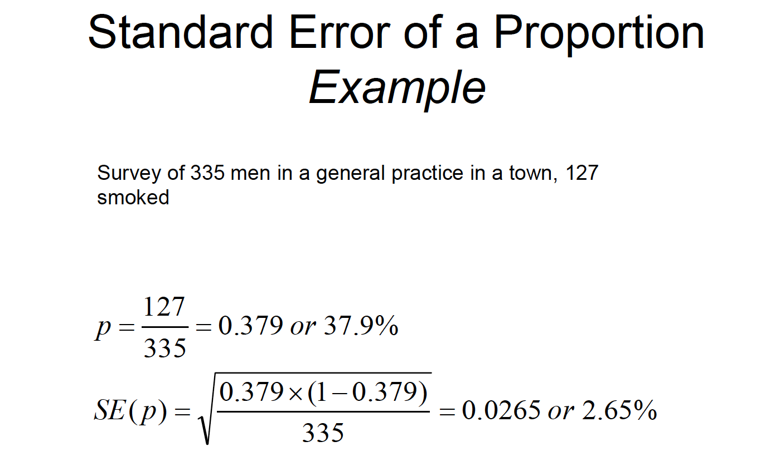

Slide 49
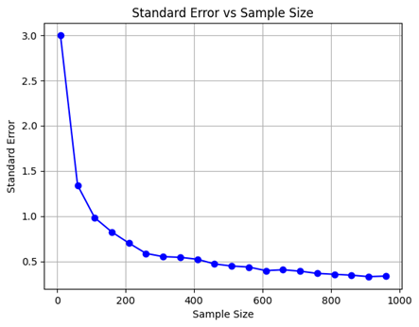
Standard Error of a Proportion Variation with Sample Size

Slide 50
95% Confidence Interval for a Proportion
It would be useful to be able to give an interval of possible values within which the true population proportion might lie.
• Using the theoretical properties of the normal distribution, it can be shown mathematically that
– p will be within 1.96 standard errors of the true proportion with probability 0.95, or
– there is 2.5% risk that p will exceed the true proportion by more than 1.96 standard errors, and 2.5% risk that p will underestimate the true proportion by more than 1.96 standard errors.

Slide 51
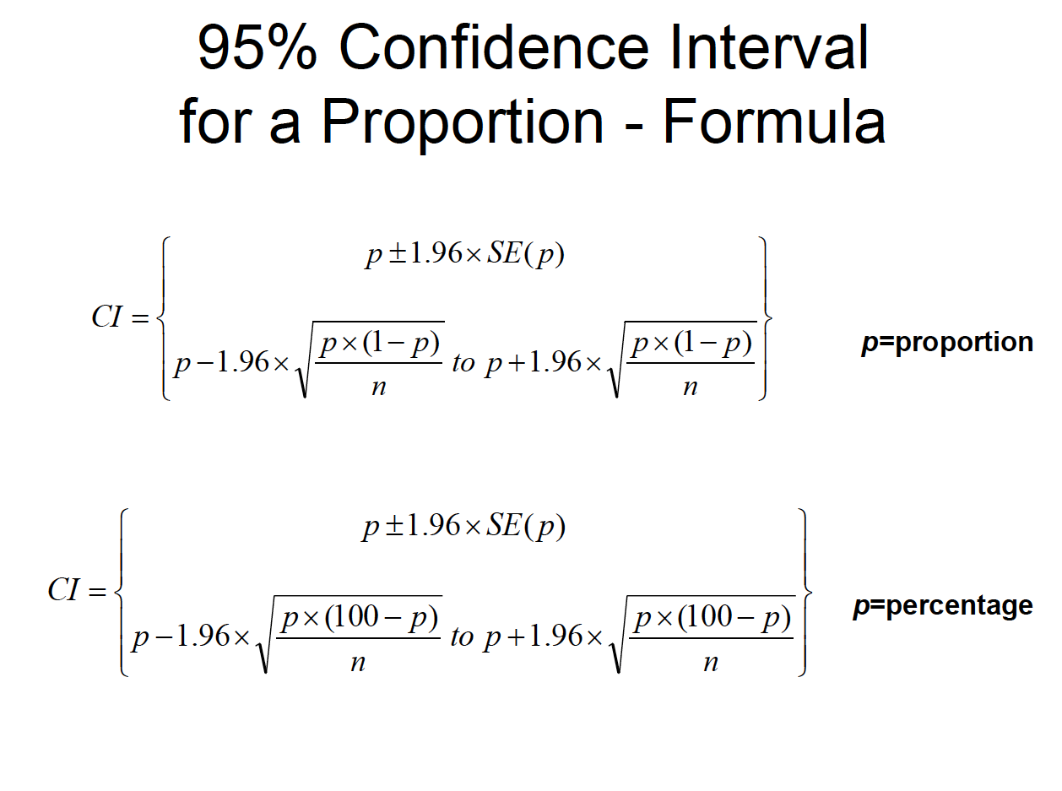

Slide 52
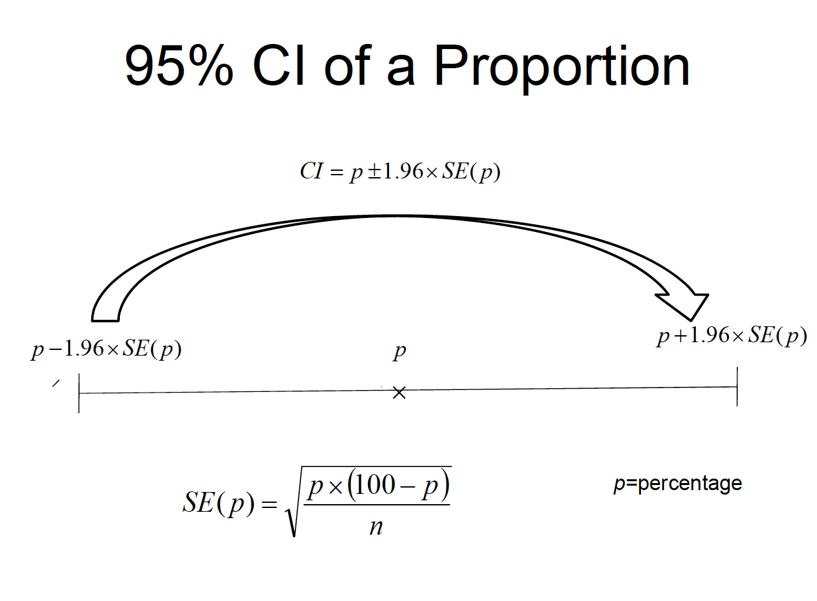

Slide 53
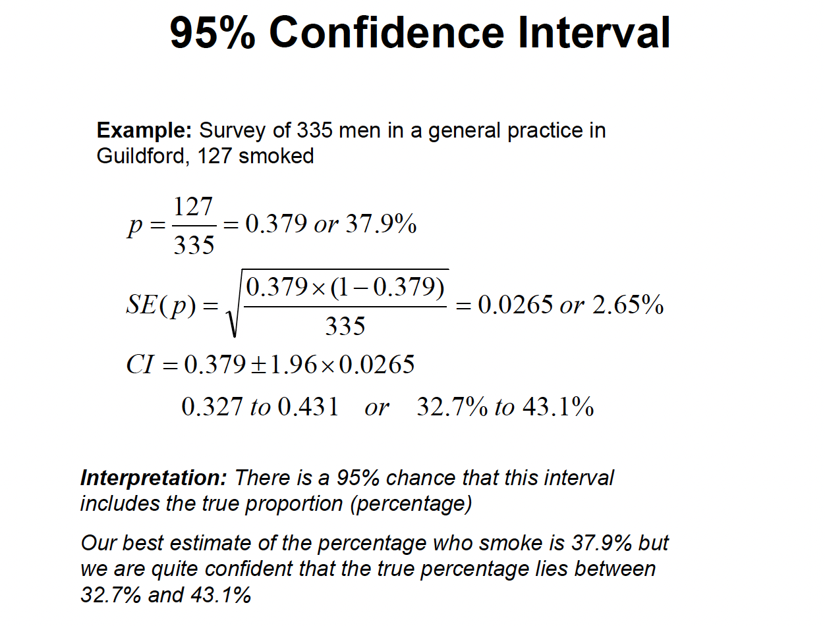

Slide 54
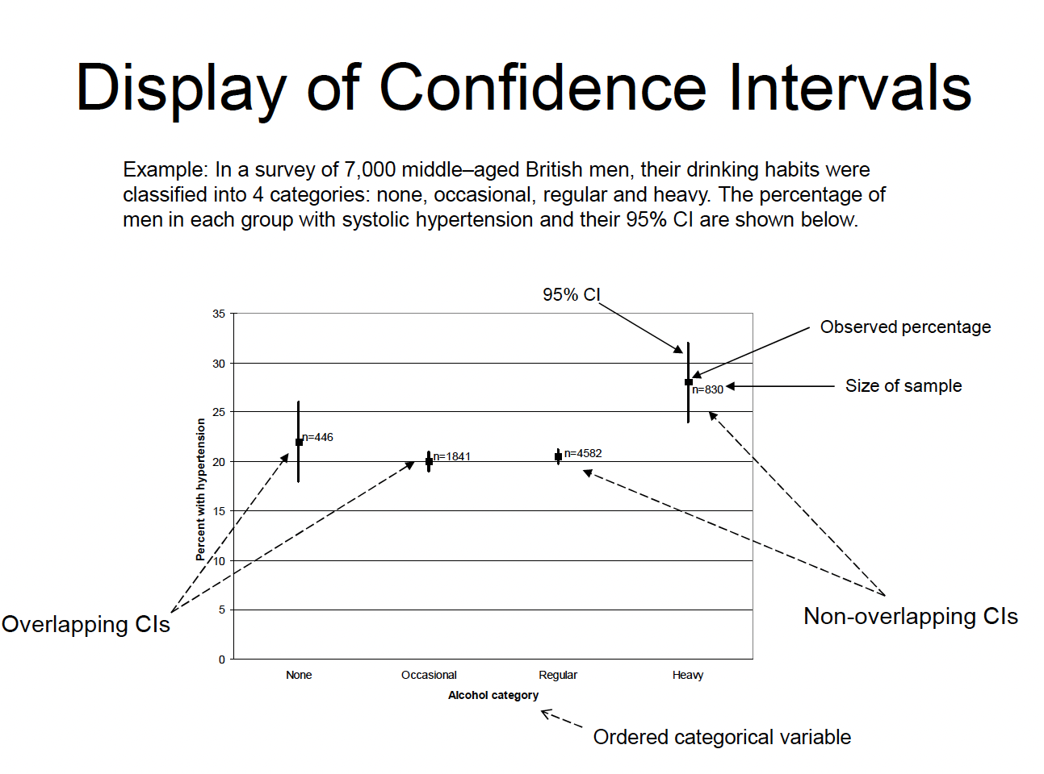

Slide 55
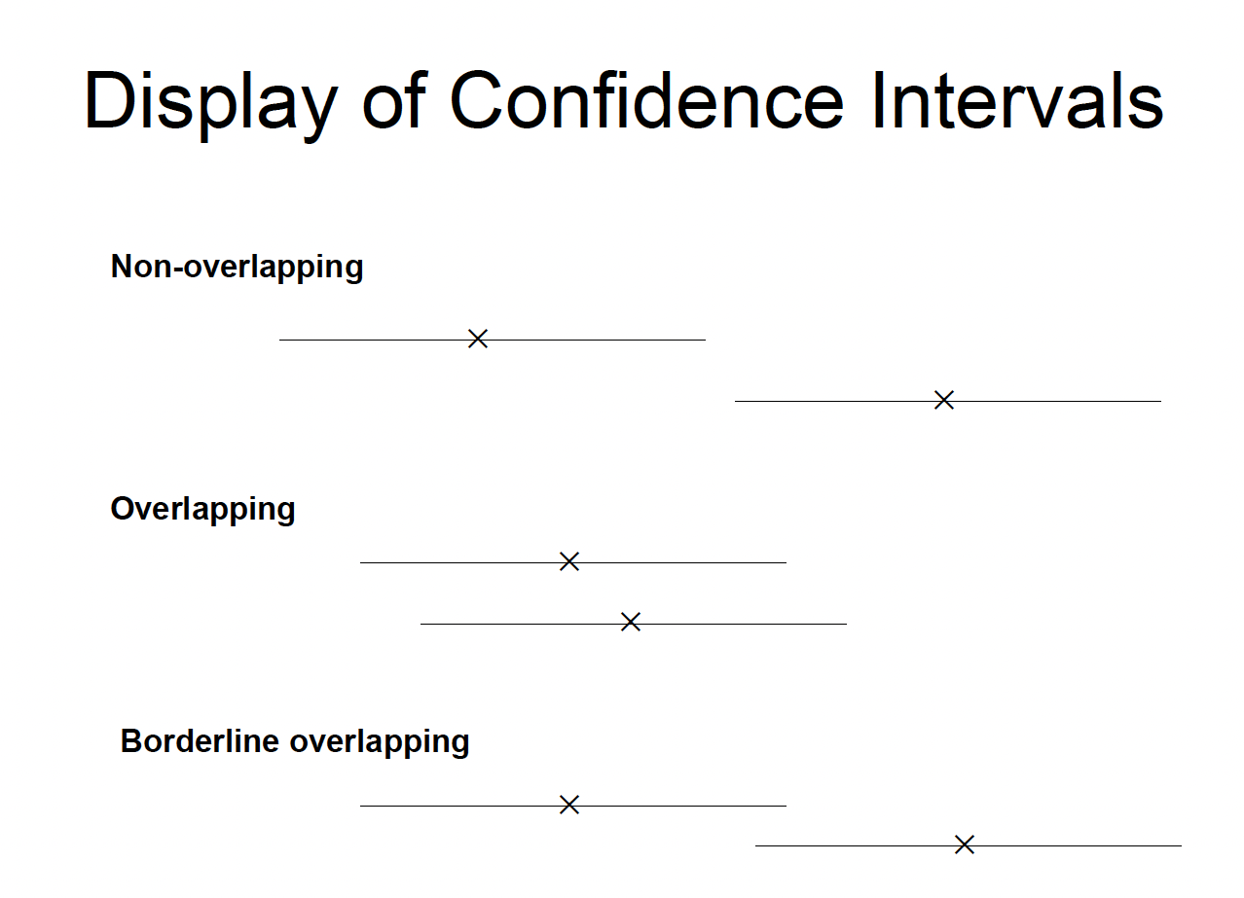

Slide 56
Method for CI for proportion
WALD interval method - what have been shown previously
Wald interval is infamous for low coverage in practical scenarios.
Clopper – Pearson Interval (Exact Interval)
Clopper-Pearson interval (also known as exact interval) came into existence with an objective to have the coverage at a minimum of 95% for all values of p and n. As the alternative name of ‘exact’ interval suggests, this interval is based on the exact binomial distribution and not on the large sample mid-p normal approximation like that of Wald interval.
Other - Agresti-Coull Interval, Wilson method, and Bayesian HPD Interval

Slide 57
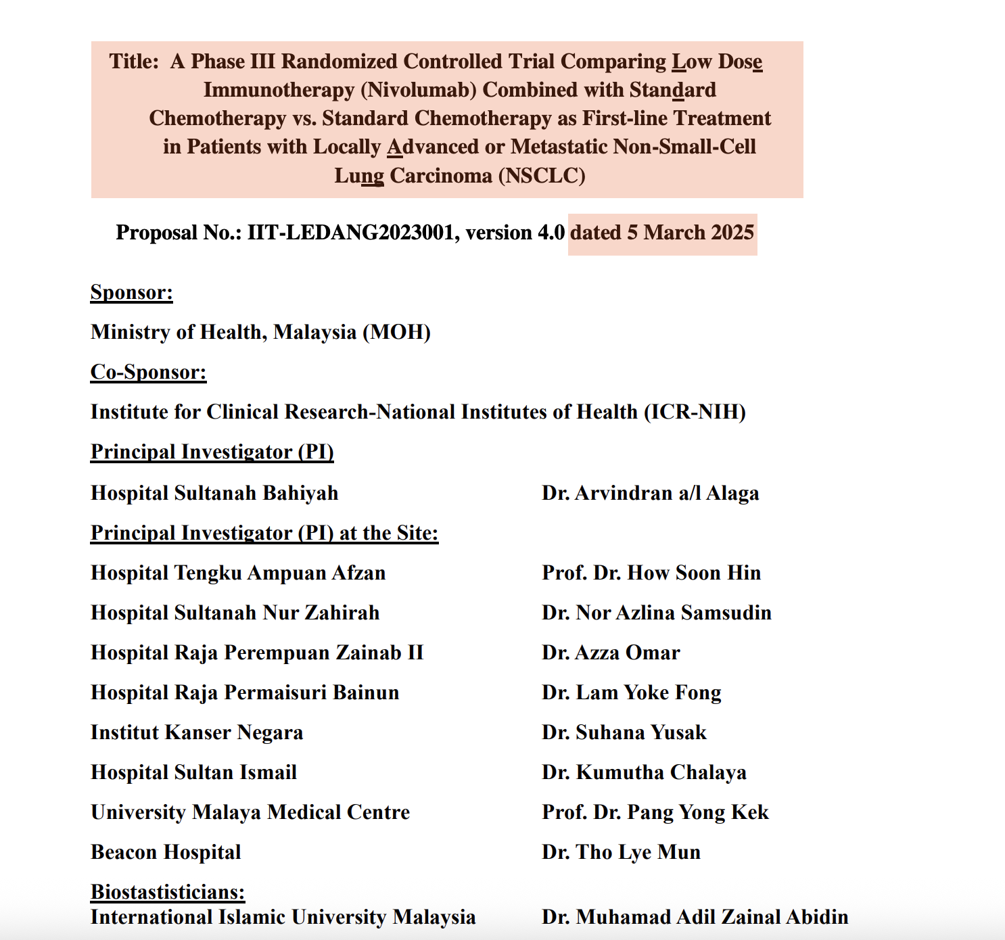
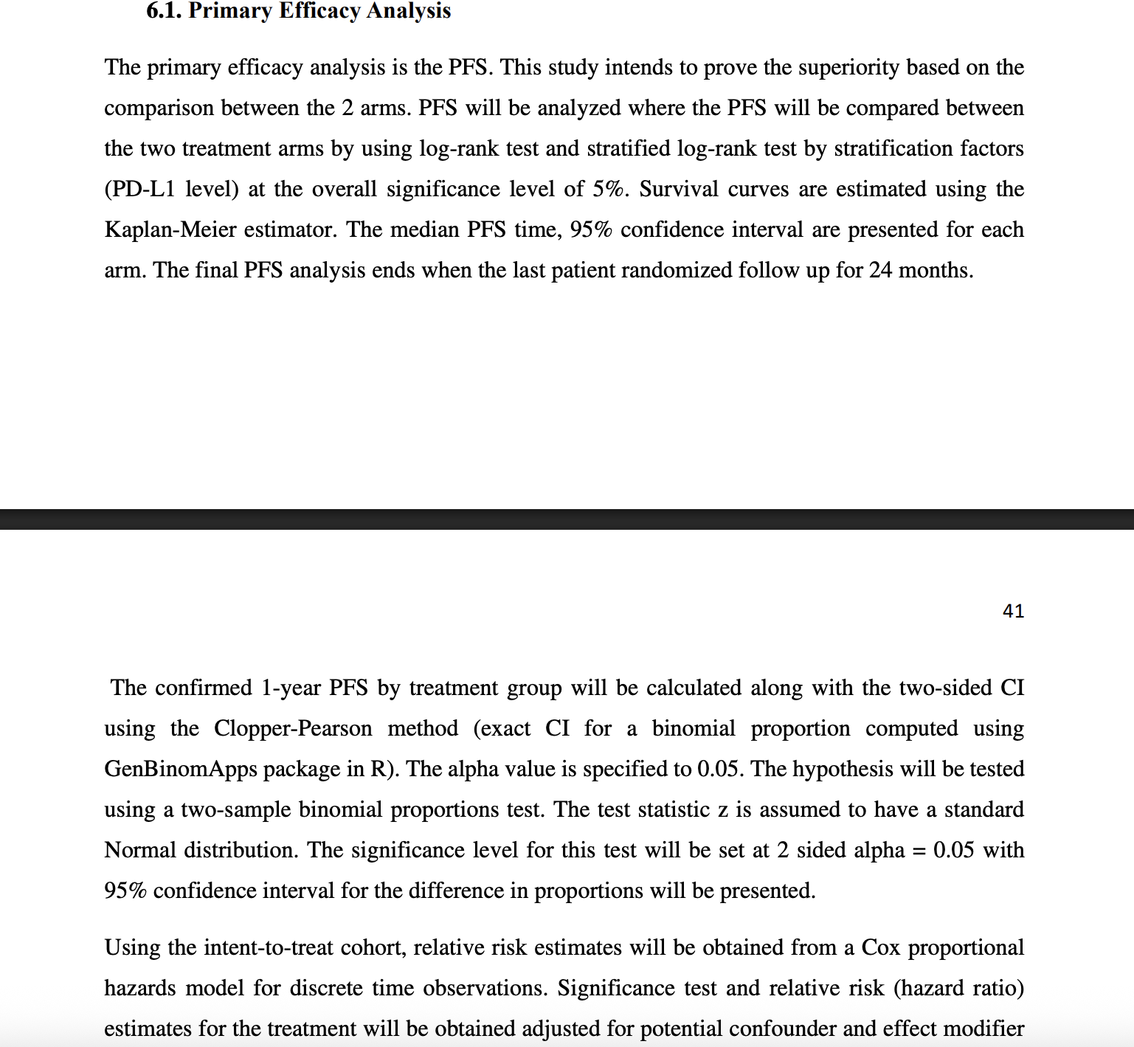
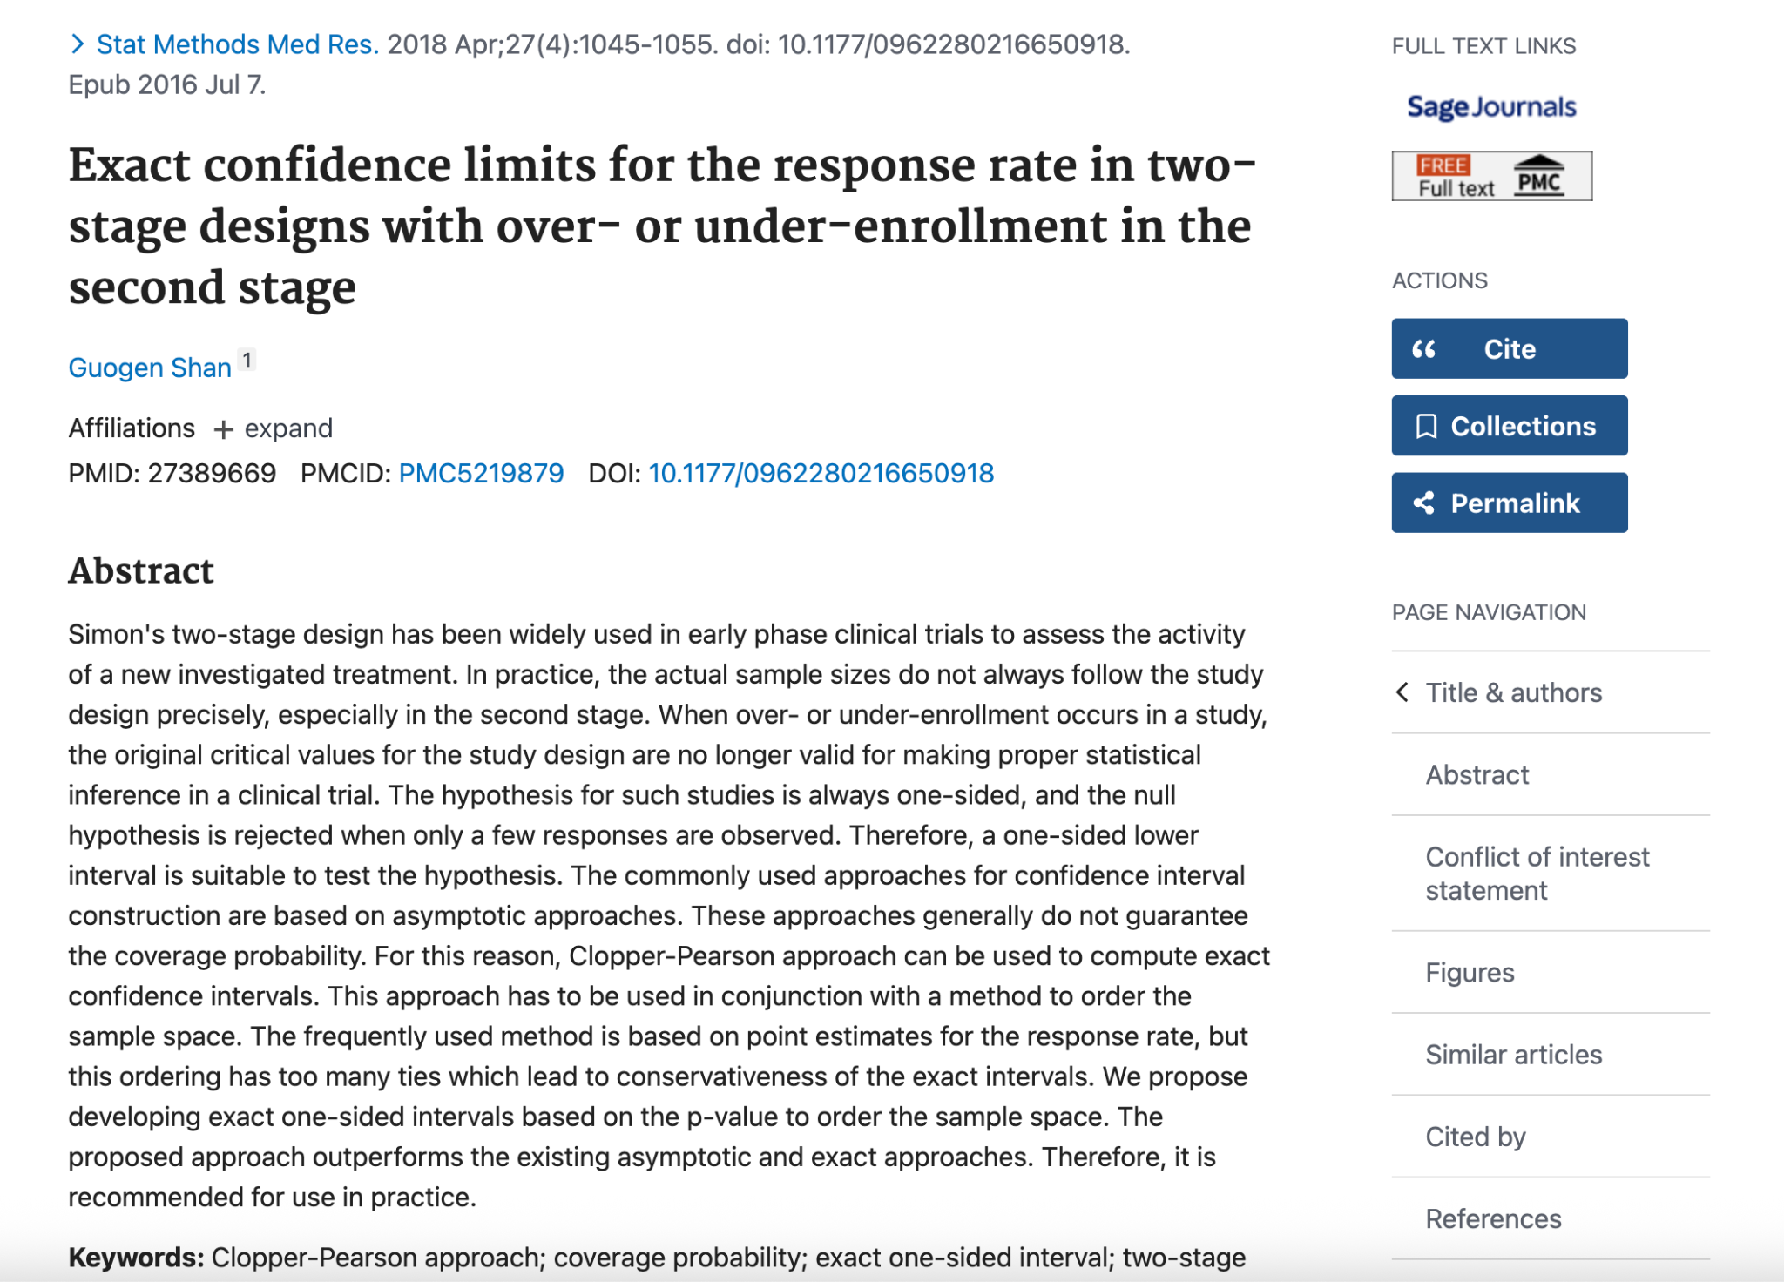
https://clinicaltrials.gov/study/NCT07050043

Slide 58
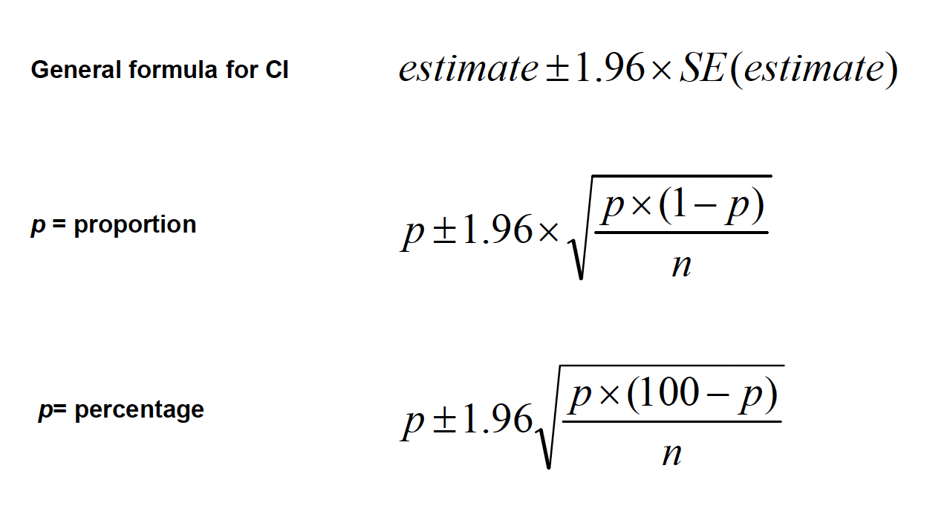

Slide 59
SUMMARY
When a sample is taken, random error (sampling variability) occurs. We have to take account of this when interpreting results.
When measuring a proportion (or percentage) in a sample, this is our best and only estimate of the true proportion (or percentage) in the population
A confidence interval gives us two limits which we are reasonably sure include the true proportion
An important factor in determining the width of the CI is the size of the sample.

Slide 60
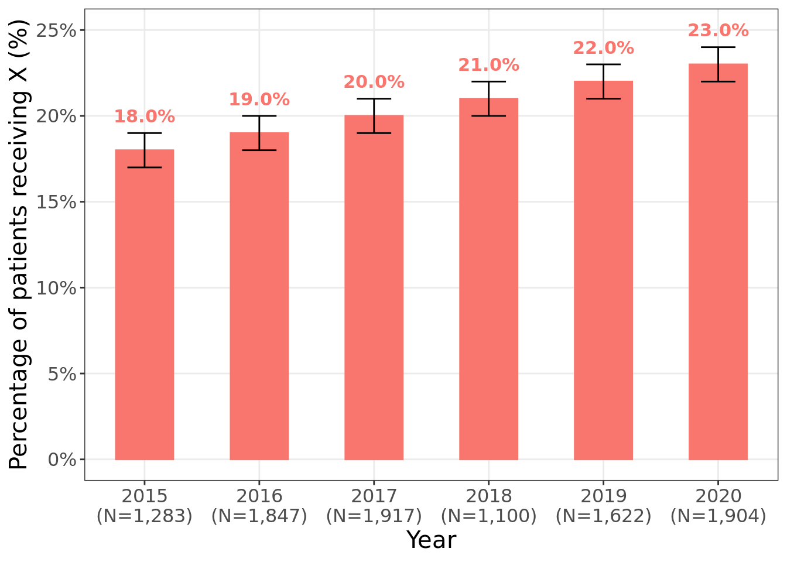

Slide 61
SAMPLING VARIABILITY FOR MEAN

Slide 62
Confidence interval for mean
Sample statistics (like the mean) vary from sample to sample.
This variability is called sampling variability.
Larger samples tend to produce more stable estimates.
The standard error quantifies the typical amount a sample mean differs from the population mean.
Formula:
SE = s / √n

Slide 63
Confidence interval for mean
A confidence interval (CI) provides a range of values likely to contain the true population mean.
It accounts for sampling variability.
A 95% confidence interval means: If we took many samples, about 95% of the intervals would contain the true mean.

Slide 64
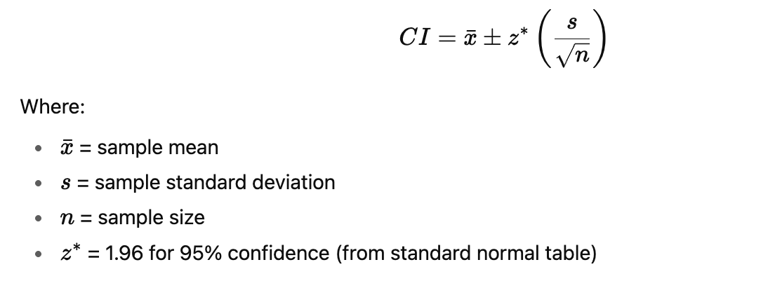
95% Confidence Interval Formula

Slide 65
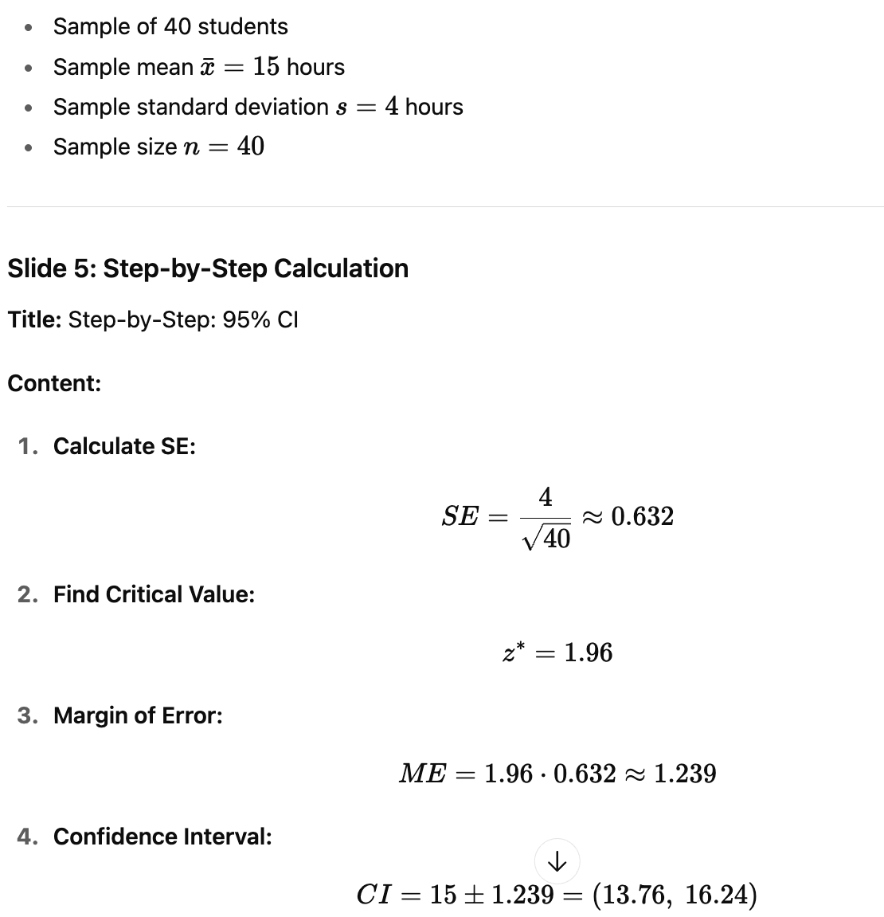
95% Confidence Interval Formula
Example

Slide 66
We are 95% confident the true mean study hours lie between 13.76 and 16.24 hours.
This range reflects the uncertainty due to sampling variability.
Larger samples → smaller SE → narrower CI → more precise estimate.

Slide 68

THANK YOU
Muhammad Adil ZA, Assoc Prof Dr
MBBS,PGDIS (IIUM) DLSHTM,MSc (Lon) MPH,DrPH (UPM) AM (Mal) FRSPH (UK)
Deputy Dean (Research, Innovation & Development), Kulliyyah of Medicine , IIUM adilza@iium.edu.my
Adjunct Professor, Universiti Islam Malaysia
Research Fellow, Faculty of Medicine, Universitas Muhammadiyah Yogyakarta muhammad.adil@umy.ac.id

